Slide 1
Decorator Pattern
En Verden af Forandringer

Slide 2
Problemstilling
Basal funktionalitet skal forøges
Nedarvning kan bliver stort
GoF
"Attach additional responsibilities to an object dynamically. Decorators provide a flexible alternative to subclassing for extending functionality."

Slide 3
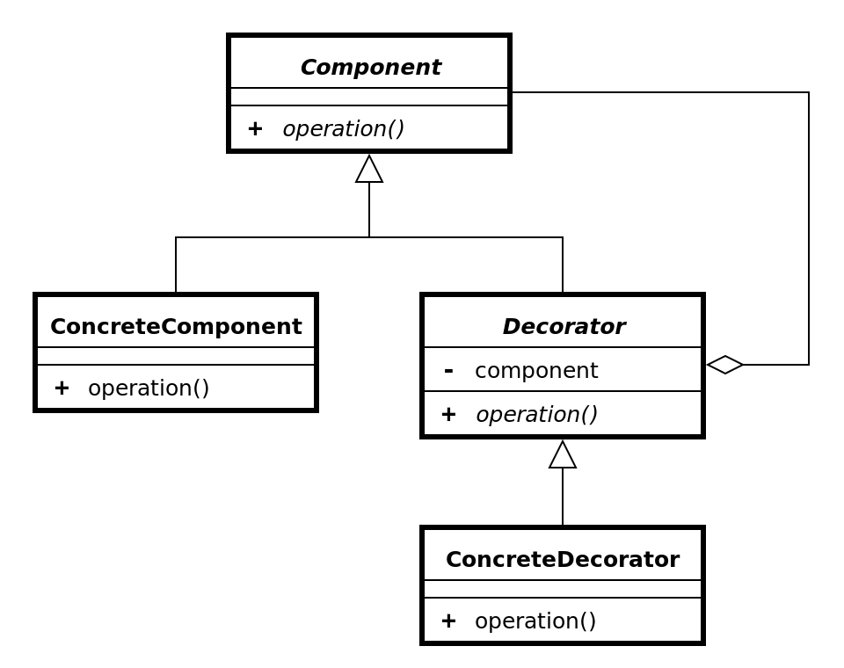
Uml

Slide 4
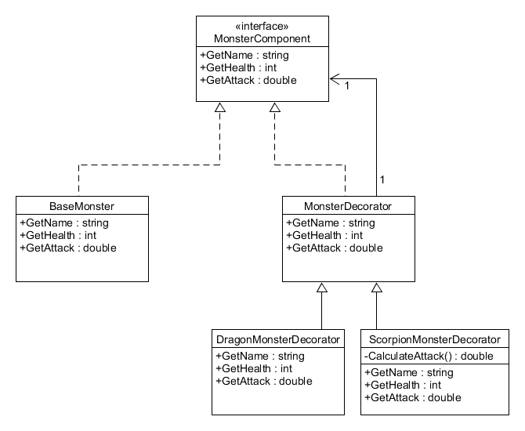
Eksempel

Slide 5
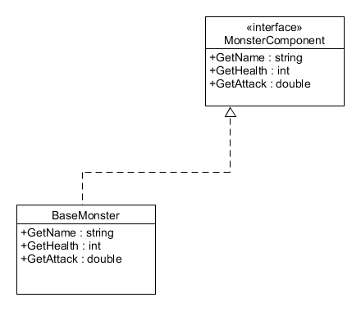
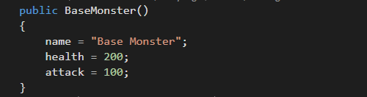

BaseMonster

Slide 6
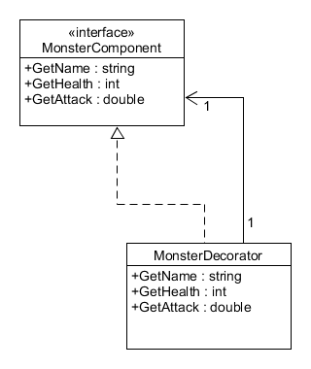
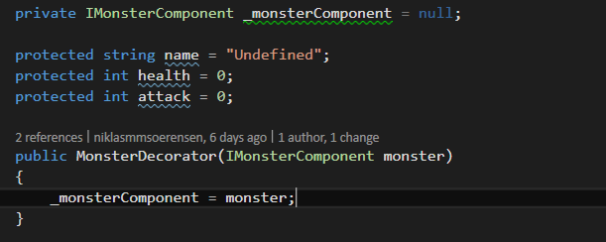
MonsterDecorator

Slide 7
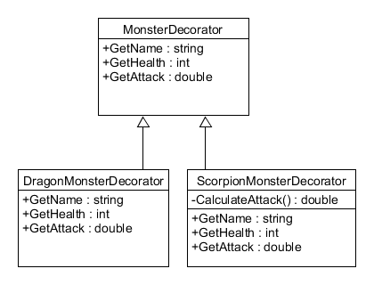
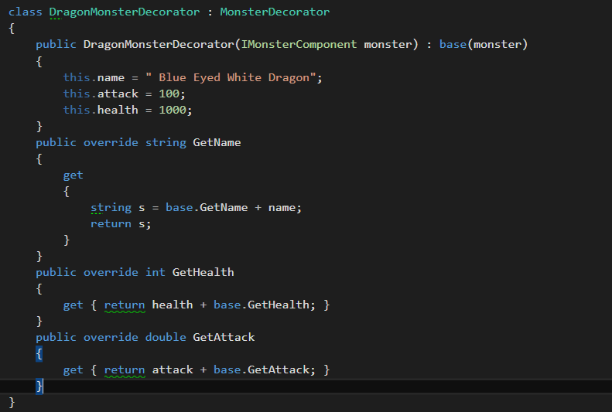
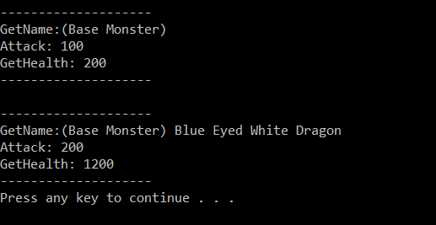
ConcreteMonsters

Slide 8
Struktur
Strategy
Template

Slide 9
Konklusion
Open Closed principle
God nytte ????

